Slide 1



The International Association for Genetics in Aquaculture, a brief historical account
Roberto Neira
University of Chile

Slide 2
Topics covered
The first International Symposium on Genetics in Aquaculture (1982)
Foundation of International Association for Genetics in Aquaculture (1985)
Rules, traditions, sites and dates of the Symposium 1982 – 2022
The first breeding programs using modern technologies in aquaculture
How have the breeding objectives, genetic tools and technologies used changed over time (analysis by groups of 9 years)
Arrival of molecular genetics, data analysis tools, genomic selection, meta-analysis of GWAS, exome sequencing, phenomics … …
Future trends of Aquaculture Genetics and Genomics
A brief description of the Chilean situation

Slide 3
The International Symposium on Genetics in Aquaculture
The need for a symposium devoted exclusively to genetics of organisms suitable for aquaculture became increasingly obvious during the early seventies.
Several F.A.O. studies, especially the Technical Conference on Aquaculture (1972) and particularly the paper of Dr. Moav at that conference, motivated Dr. Noël Wilkins to organize the first International Symposium on Genetics in Aquaculture in 1982.
Two other important geneticists, Dr. Trygve Gjedrem (Norway) and Dr. Graham A.E. Gall (USA) joined Dr. Wilkins in this initiative.

Slide 4
International Association for
Genetics in Aquaculture (IAGA)
Following the first International Symposium on Genetics in Aquaculture held at University College, Galway, Ireland in 1982, the second symposium was agreed to take place at UC Davis in 1985, when the International Association for Genetics in Aquaculture (IAGA) was founded.
PURPOSE:
To promote communication concerning all aspects of aquatic animal and plants of aquacultural importance, to provide a mechanism for a triennial meeting known as “The Xth International Symposium on Genetics in Aquaculture”, and to ensure publication of the proceedings of each symposium.
(IAGA Constitution, 1985)

Slide 5
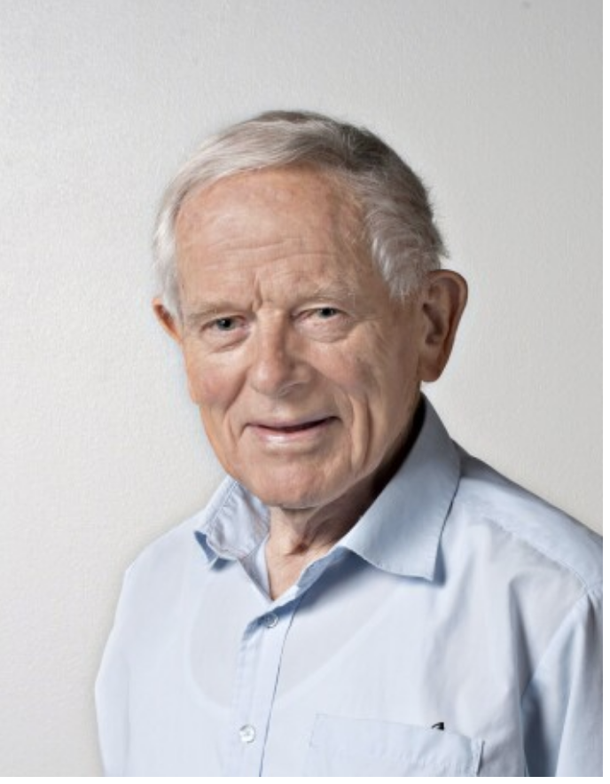
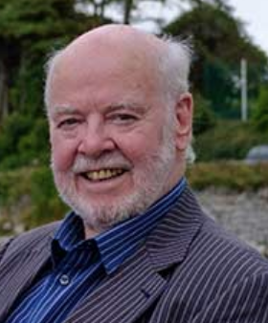
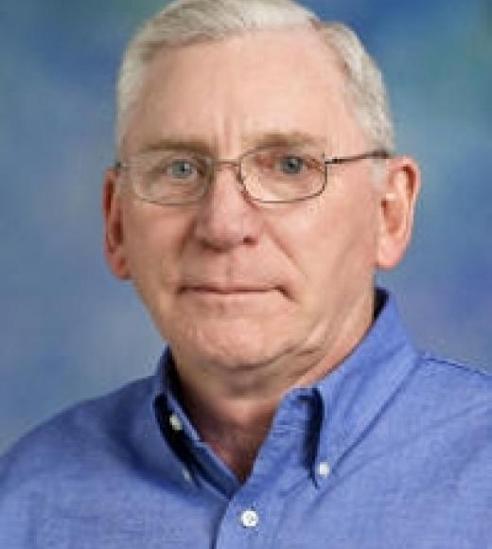
The Founders
Dr. Noël Wilkins University College
Galway, Ireland
Dr. Trygve Gjedrem
Institute of Aquacultural
Research, Norway
Dr. Graham A.E. Gall
University of California, Davis, USA
During the opening ceremony of ISGA VIII, on its 21st anniversary of the first symposium held at Puerto Varas, in 2003, the Board of Directors recognized and honored the founding fathers of the IAGA: Dr. Noël Wilkins as the initiator, organizer and host of the first gathering of aquacultural geneticists, Dr. Trygve Gjedrem and Dr. Graham Gall for their unstinting efforts over the many years that have resulted in the initiation, continuation and success of the IAGA.

Slide 6
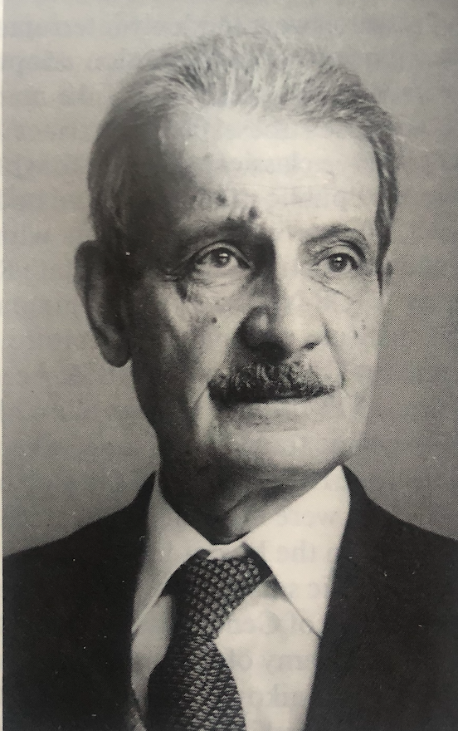

First Honorable Member of IAGA
Valentin Sergeevich Kirpichnikov
1908 - 1991
On the occasion of the Fourth International Symposium on Genetics in Aquaculture, held 29 April to 3 May 1991 in Wuhan, China, Valentin S. Kirpichnikov was honored by being chosen as the first Honorable Member of the International Association for Genetics in Aquaculture (IAGA)
Notes:
he passed away in november 14th that year

Slide 7
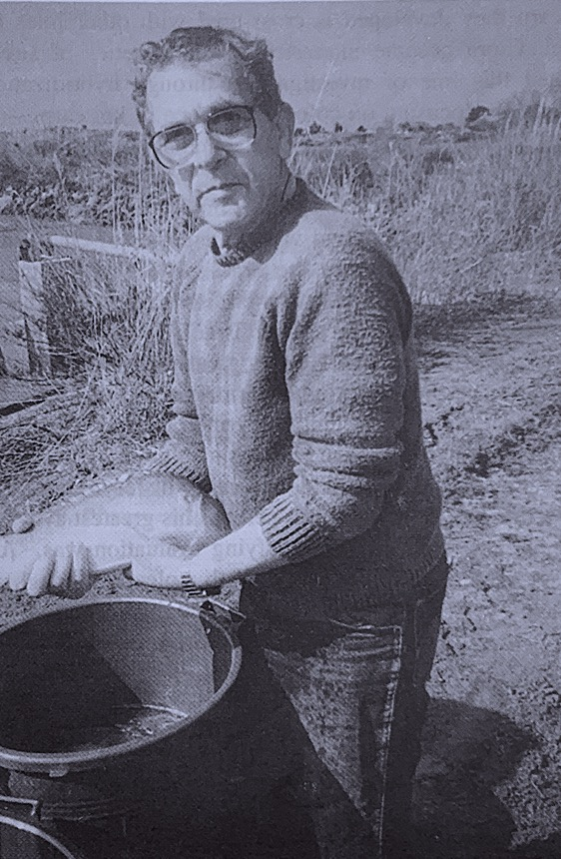
In Memoriam
Giora Werner Wohlfarth
1927 - 1994
In the special Issue of Aquaculture Vol 173 (1999) ISGA VI, a heartfelt tribute is made for the death of Giora W. Wohlfarth. He was a pioneer in the area of fish breeding, contributing substantially to the study of genetics in the culture of carp and tilapia

Slide 8
I.A.G.A. Constitution (1985)
First three Board of Directors
1985-1988
President T. Gjedrem
Vice-Pres N. Wilkins
Sec/Tres G. Gall
1988-1991
President H. Chen
Vice-Pres T. Gjedrem
Sec/Tres G. Gall
1991-1994
President R. Doyle
Vice-Pres H. Chen
Sec/Tres G. Gall
Board of Directors
  President (organizing the next symposium)
  Vice-President (immediate past president)
  Secretary/Treasurer
Business Meetings
  A business meeting of active members of IAGA shall be held during each triennial symposium
  Active members are those attending the symposium and voting
  The main decision of the Business Meeting is to decide the site for the next triennial symposium.
  The person representing the next meeting becomes the ISGA President

Slide 9
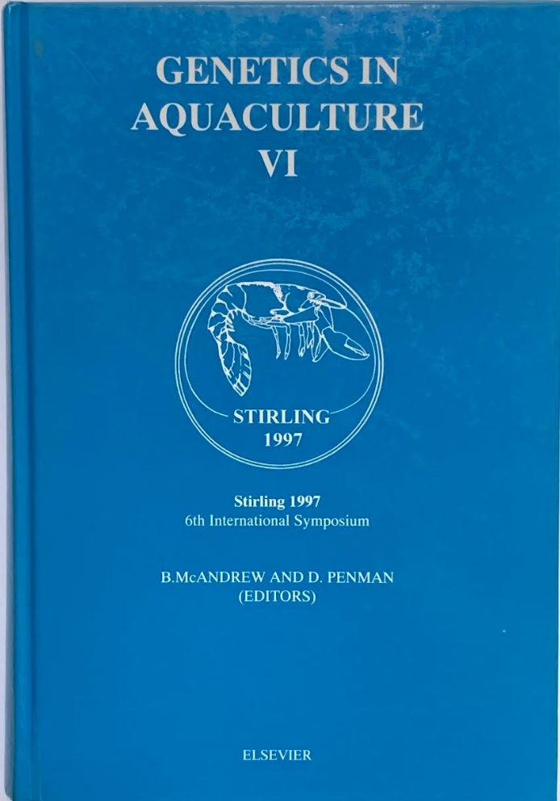

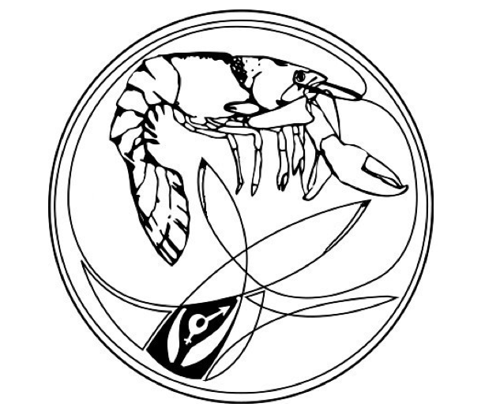

Emblems of IAGA
Marc Doucey
Notes:
Gif of french researcher at Montpellier 2006

Slide 10
Some other rules
Fees: Initially there was a 40.00 USD for a three year period
Meeting location: Initially there was a rotation: Europe, North America, Asia
Proceedings: Each Symposium is published as a special issue of Aquaculture
Poster Session: To balance the desire not to have concurrent sessions. Single session symposium.
Duration: One week in length with at least one half-day free for relaxation
Sites of the Symposium: The Board of Directors receives invitations and/or nominations regarding the site of future meetings. The presidential candidate is expected to have attended at least one symposium.

Slide 11
Genetics in Aquaculture | Year | City | Conference Chair | Published in Aquaculture
I. | 1982 | Galway, Ireland | Noel Wilkins | VOL 33 1983
II. | 1985 | Davis, USA | Graham Gall | VOL 57 1986
III. | 1988 | Oslo, Norway | Trygve Gjedrem | VOL 85 1990
IV. | 1991 | Wuhan, China | Hongxi Chen | VOL 111 1993
V. | 1994 | Halifax, Canada | Roger Doyle | VOL 137 1996
VI. | 1997 | Stirling, Scotland | Brendan McAndrew | VOL 173 1999
VII. | 2000 | Townsville, Australia | John Benzie | VOL 204 2002
VIII. | 2003 | Puerto Varas, Chile | Roberto Neira | VOL 247 2005
IX. | 2006 | Montpellier, France | Béatrice Chatain | VOL 272 2007
X. | 2009 | Bangkok, Thailand | Uthairat Na-Nakorn | VOL 308 2010
XI. | 2012 | Auburn, USA | Rex Dunham | VOL 420 2014
XII. | 2015 | Stgo. Compostela, España | Paulino Martínez | VOL 472 2017
XIII. | 2018 | Cairns, Australia | Dean Jerry | VOL
XIV. | 2021 | Puerto Varas, Chile | José Yáñez | VOL

Slide 12
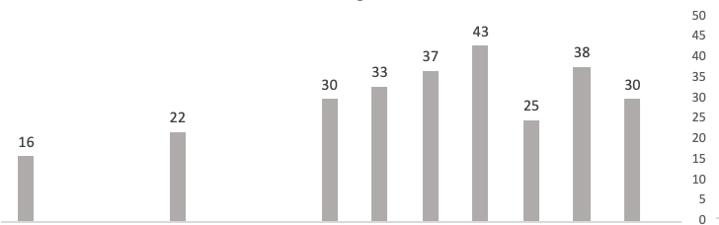
Registered attendance
from “n” countries
286
EUROPE
ASIA
N. AMERICA
AUSTRALIA
S. AMERICA
36

Slide 13
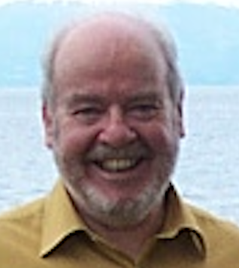
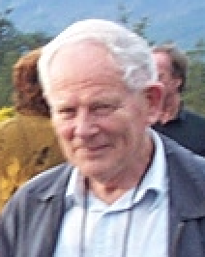
Symposium ISGA I (1982) Galway, Ireland
Noel Wilkins
Symposium ISGA II (1985) Davis, USA
Graham Gall
Symposium ISGA III (1988) Oslo, Norway
Trygve Gjedrem

Slide 14
PUBLISHED PAPERS IN SPECIAL ISSUES OF AQUACULTURE ON EACH SESSION
SESSIONS | Galway 1882 | Davis 1885 | Oslo 1988 |  | Wuhan 1991 | Halifax 1994 | Stirling 1997 |  | Townsvi 2000 | P Varas 2003 | Montp 2006 |  | Bangko 2009 | Auburn 2012 | S Comp 2015 |  | Cairns 2018 | P Varas 2022
Population Genetics, genetic diversity, Electrophoretic Markers | 4 | 4 | 1 | 9 | 5 | 2 |  | 7 |  | 2 | 5 | 7 | 3 |  |  | 3
Quantitative Genetics, Breeding Plans, Selection Response, Environmental Effects | 12 | 8 | 9 | 29 | 8 | 8 | 9 | 25 | 12 | 6 | 8 | 26 | 6 | 7 | 7 | 20
Domestication and Response to Controlled Environments | 4 | 7 |  | 11 |  |  |  |  |  |  |  |  |  |  |  | 0
Inbreeding, Inbreeding Effects | 3 |  |  | 3 |  |  |  |  |  | 2 |  |  | 2 | 1 |  | 3
Hybrids and Hybridization | 4 |  |  | 4 |  | 3 |  | 3 |  |  |  |  |  |  |  | 0
Chromosomal Genetics and Ploidy Manipulations, | 4 | 7 | 2 | 13 | 7 | 4 | 4 | 15 | 5 | 5 | 2 | 12 | 2 | 1 |  | 3
Sex Reversal and Monosex, sex control, Sex determination | 3 | 2 |  | 5 |  | 1 | 5 | 6 |  |  | 1 | 1 | 2 | 1 |  | 3
Applications of Ploidy Manipulation. P |  | 2 |  | 2 |  | 2 | 1 | 3
Stock and strain Comparison, |  | 5 |  | 5
Immunology, Disease resistance & stress |  |  | 5 | 5 | 2 |  |  | 2 |  |  | 2 | 2 | 3 |  |  | 3
New fish species |  |  | 3 | 3 |  |  |  |  |  |  |  |  |  |  |  | 0
Transgenic fish, Molecular manipulation |  |  |  |  | 4 | 3 | 6 |  |  |  |  |  |  | 2 |  | 2
Conservation, Natural & cultivated Genetic resources |  |  |  |  |  | 5 | 7 | 12 | 2 | 7 |  | 9 | 1 | 1 |  | 2
Genetic markers (AFLP, QTL, RFLP, RAPD, MicroS) Genome Mapping, MAS |  |  |  |  |  | 1 | 8 | 9 | 4 | 4 | 5 | 13 | 5 | 4 | 2 | 11
Gene expression, functional genomics |  |  |  |  |  |  |  |  | 1 |  |  | 1 |  |  | 2 | 2
Genome selection, Genomic prediction |  |  |  |  |  |  |  |  |  |  |  |  |  | 2 | 2 | 4

Slide 15
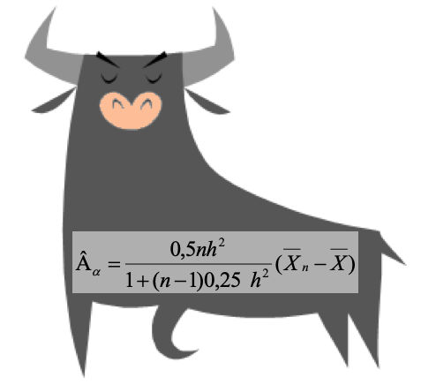
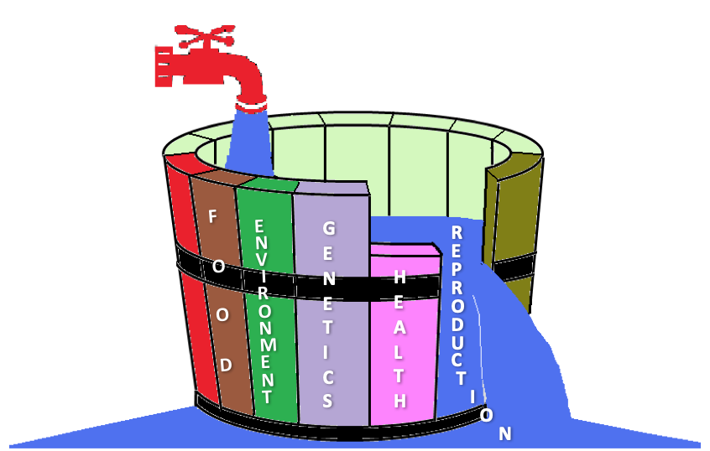
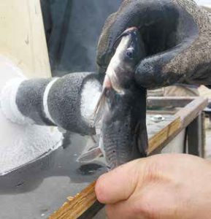
ADOPTING ANIMAL BREEDING THEORY
Animal husbandry theory had only recently been applied to fish farming and had not been widely practiced in aquatic species.
The main problem at the time, in using effective breeding schemes had been controlling reproduction and mating.
The development of a better tagging system, than freeze-branding, at a reasonable cost, was limiting the use of better selection schemes to identify future parents

Slide 16
BREEDING FOR STOCK ENHANCEMENT AND OCEAN RANCHING
Hatchery propagation has resulted in significant losses of heterozygosity
Some of the factors listed as potentially affecting return rate were health of the fish in the hatchery, spawning season manipulation, timing of release, choice of release site including presence of predators, and selection of spawners with regard to age, size and year-class. Domestication selection.

Slide 17
INBREEDING
The error most often made appears to be the assumption that high fecundity negates the need for large numbers of spawners, with the result that the effective population sizes of breeding populations are often extremely small.
What are the effects of inbreeding and how important are they
It appears that selection with a balanced avoidance of inbreeding offers the most attractive approach for the near future.

Slide 18
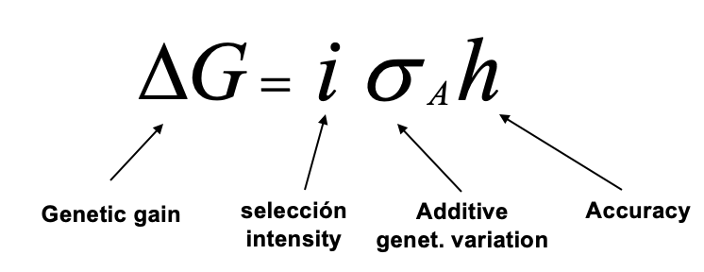
QUANTITATIVE GENETICS AND SELECTION
The nature of quantitative characters, the usefulness of additive genetic differences, the value of parameter estimates and the effectiveness of selection
There was an overriding conclusion that additive genetic variation constitutes the greatest genetic resource available for stock improvement and that selection, in most instances, is the most effective method of genetic improvement available to fish breeders

Slide 19
BREEDING PLANS, SELECTION RESPONSE
Expression of the opinion that mass selection in fish was not effective brought large attention. (Moav and Wohlfarth, 1976)
By the end of this period, good possibilities for obtaining genetic change through breeding programs have been demonstrated
A combination of between family and individual selection is necessary to achieve effective genetic gains for traits with low to medium heritability, the situation for most performance traits.

Slide 20
COMPARING STOCKS, LINES OR FAMILIES
There was general agreement that there is strong evidence to indicate the presence of sometimes rather large genetic differences, both additive and non-additive, among various strains and stocks.
Communal testing is the simplest and least expensive but it has the disadvantage of requiring an extensive marking program.
The lack of effective marking technology results in limited pedigree identification in communal ponds or tanks. Often the only identification is of stocks, and in most other cases the families

Slide 21
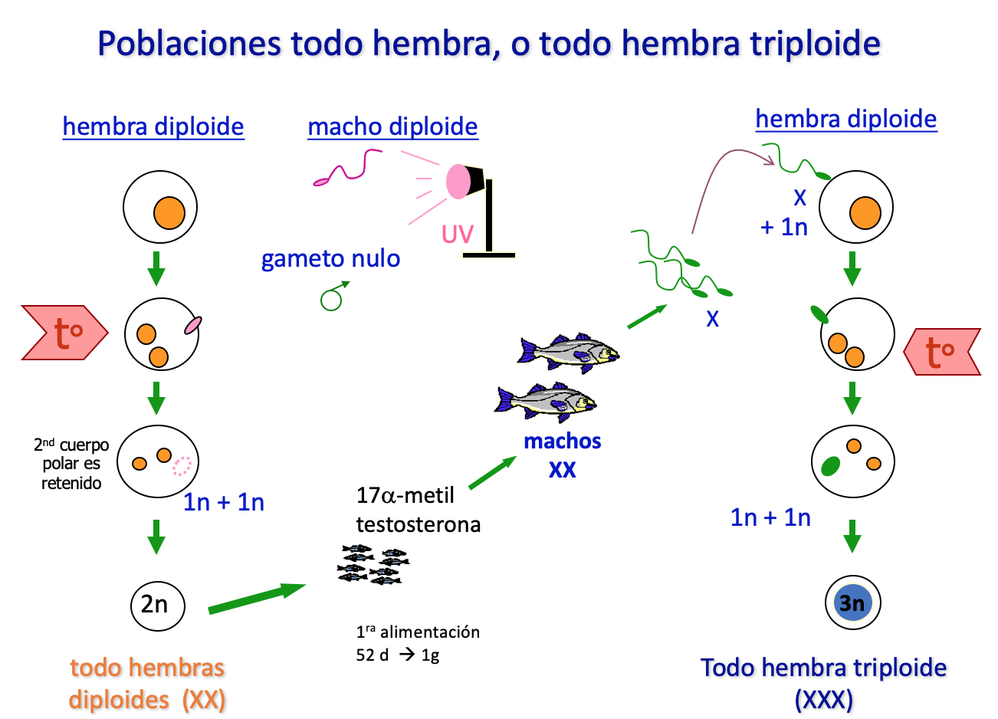
MANIPULATIONOF SEX AND PLOIDY
Sex reversal techniques, using synthetic hormone treatments, were at the time available. However, it was agreed that treatment on a production scale should not be the recommended procedure.
It was suggested that the gynogenetic fish be
sex reversed with hormone treatments to
provide a male brood stock which could be
outcrossed to unrelated normal females to
produce all-female crossbred progeny..

Slide 22
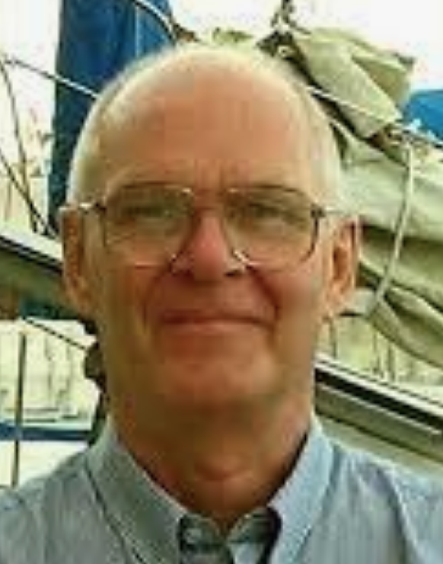
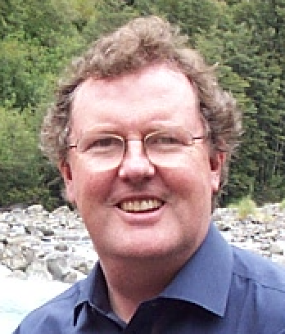
Symposium ISGA IV (1991) Wuhan, China
Hongxi Chen
Symposium ISGA V (1994) Halifax, Canada
Roger Doyle
Symposium ISGA VI (1997) Stirling, Scotland
Brendan McAndrew

Slide 23
PUBLISHED PAPERS IN SPECIAL ISSUES OF AQUACULTURE ON EACH SESSION
SESSIONS | Galway 1882 | Davis 1885 | Oslo 1988 |  | Wuhan 1991 | Halifax 1994 | Stirling 1997 |  | Townsvi 2000 | P Varas 2003 | Montp 2006 |  | Bangko 2009 | Auburn 2012 | S Comp 2015 |  | Cairns 2018 | P Varas 2022
Population Genetics, genetic diversity, Electrophoretic Markers | 4 | 4 | 1 | 9 | 5 | 4 |  | 9 |  | 2 | 5 | 7 | 3 |  |  | 3
Quantitative Genetics, Breeding Plans, Selection Response, Environmental Effects | 12 | 8 | 9 | 29 | 8 | 8 | 9 | 25 | 12 | 6 | 8 | 26 | 6 | 7 | 7 | 20
Domestication and Response to Controlled Environments | 4 | 7 |  | 11 |  |  |  |  |  |  |  |  |  |  |  | 0
Inbreeding, Inbreeding Effects | 3 |  |  | 3 |  |  |  |  |  | 2 |  |  | 2 | 1 |  | 3
Hybrids and Hybridization | 4 |  |  | 4 |  | 3 |  | 3 |  |  |  |  |  |  |  | 0
Chromosomal Genetics and Ploidy Manipulations, | 4 | 7 | 2 | 13 | 7 | 4 | 4 | 15 | 5 | 5 | 2 | 12 | 2 | 1 |  | 3
Sex Reversal and Monosex, sex control, Sex determination | 3 | 2 |  | 5 |  | 1 | 5 | 6 |  |  | 1 | 1 | 2 | 1 |  | 3
Applications of Ploidy Manipulation. Polyploid performance |  | 2 |  | 2 |  | 2 | 1 | 3
Stock and strain Comparison, |  | 5 |  | 5
Immunology, Disease resistance & stress |  |  | 5 | 5 | 2 |  |  | 2 |  |  | 2 | 2 | 3 |  |  | 3
New fish species |  |  | 3 | 3 |  |  |  |  |  |  |  |  |  |  |  | 0
Transgenic fish, Molecular manipulation |  |  |  |  | 4 | 3 | 6 | 13 |  |  |  |  |  | 2 |  | 2
Conservation, Natural & cultivated Genetic resources |  |  |  |  |  | 5 | 7 | 12 | 2 | 7 |  | 9 | 1 | 1 |  | 2
Genetic markers (AFLP, QTL, RFLP, RAPD, MicroS) Genome Mapping, MAS |  |  |  |  |  | 2 | 8 | 10 | 4 | 4 | 5 | 13 | 5 | 4 | 2 | 11

Slide 24
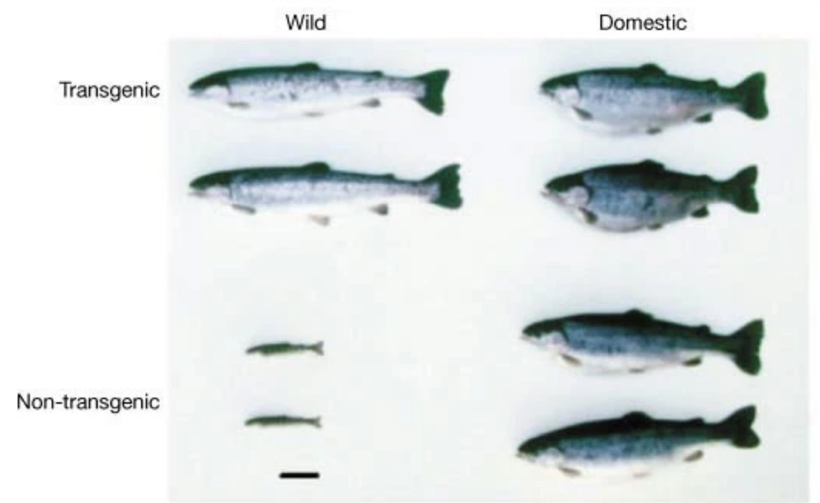
GENE TRANSFER, TRANSGENIC FISH
Gene transfer enters as a subject of great possibilities for the genetic improvement of fish
Methodologies and possible targets are discussed: disease resistance, cold tolerance are candidate traits. Most of trails are with GH.
The first work with salmon presented in ISGA
was the work with coho salmon
Then came the perspective of conservation, risk
assessment, risk management of GMO organisms.
Devlin, et al, 1995
Notes:
Bob Devlin

Slide 25
QUANTITATIVE GENETICS AND SELECTION
The nature of quantitative characters and the genetic parameter estimates continues, together with definition of breeding objectives for commercial production and the design of breed improvement programs.
A series of work that were the foundation of
the Genetic improvement of farmed tilapia (GIFT)
program are presented.
The use of animal models, based on BLUP procedures
are introduced in fish selection programs
Genetic improvement of disease resistance, introducing methods of challenge tests with family groups with specific pathogens

Slide 26
CHROMOSOME AND PLOIDY MANIPULATION
Polyploidy and gynogenesis are tested to produce sterile progeny for culture, for sex manipulation and to produce highly inbred or cloned lines for crossbreeding and for research purposes.
Successful manipulation techniques in several species, mainly in tilapias, carps, Pacific and pearl oysters, catfish and trouts are reported. Results on commercial sized field trails on carp and tilapia were presented.

Slide 27
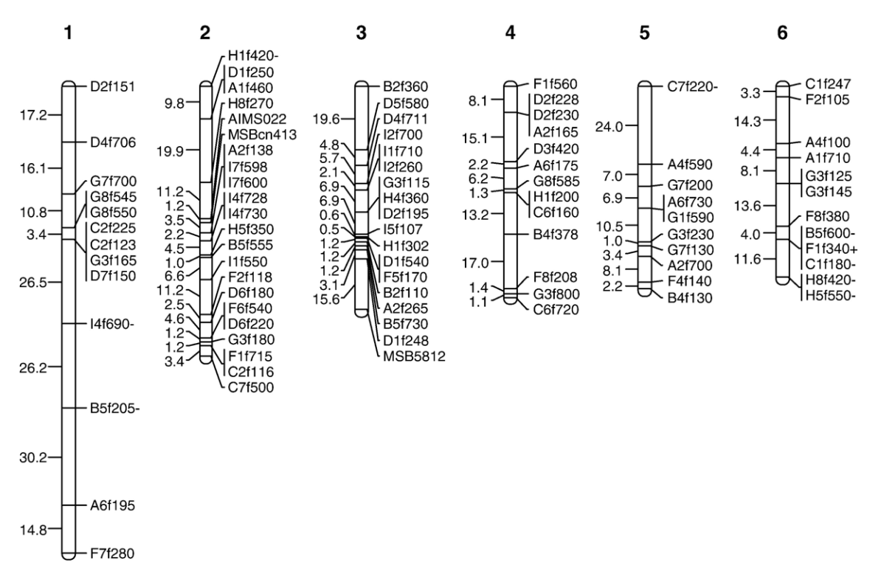
GENETIC MARKERS AND THEIR APPLICATION
At the end of this period a new set of genetic markers and related technologies came into place, AFLP, RFLP, QTL’s and particularly microsatellite loci, in the management of aquatic species and in the integration and assisting genetic improvement programs (MAS).
Linkage analysis of QTL revealed markers associated with spawning time, high temperature tolerance, IHN virus resistance in rainbow trout.

Slide 28
CONSERVATION, GENETIC RESOURCES AND MANAGEMENT
The introduction of gene transfer methods, and chromosomal manipulations put on the table the concern about the use of GMO's.
Risk assessment and management into policies on aquatic GMO’s have been adopted.
Great interest in the conservation of aquaculture species was reflected by several studies on the genetic structure and genetic variability in various species (seabream, coho salmon, common carp, lobster, Atlantic salmon) using allozymes, microsatellites, or both.

Slide 29

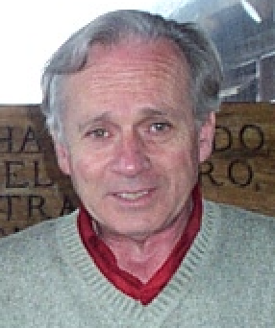
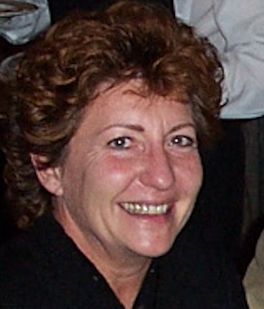
Symposium ISGA VII (2000) Townsvile, Australia
John Benzie
Symposium ISGA VIII (2003) Puerto Varas, Chile
Roberto Neira
Symposium ISGA IX (2006) Montpellier, France
Béatrice Chatain

Slide 30
PUBLISHED PAPERS IN SPECIAL ISSUES OF AQUACULTURE ON EACH SESSION
SESSION | Galway 1882 | Davis 1885 | Oslo 1988 |  | Wuhan 1991 | Halifax 1994 | Stirling 1997 |  | Townsvi 2000 | P Varas 2003 | Montp 2006 |  | Bangko 2009 | Auburn 2012 | S Comp 2015 |  | Cairns 2018 | P Varas 2022
Population Genetics, genetic diversity, Electrophoretic Markers | 4 | 4 | 1 | 9 | 5 | 4 |  | 9 |  | 2 | 5 | 7 | 3 |  |  | 3
Quantitative Genetics, Breeding Plans, Selection Response, Environmental Effects | 12 | 8 | 9 | 29 | 8 | 8 | 9 | 25 | 12 | 6 | 8 | 26 | 6 | 7 | 7 | 20
Domestication and Response to Controlled Environments | 4 | 7 |  | 11 |  |  |  |  |  |  |  |  |  |  |  | 0
Inbreeding, Inbreeding Effects | 3 |  |  | 3 |  |  |  |  |  | 2 |  |  | 2 | 1 |  | 3
Hybrids and Hybridization | 4 |  |  | 4 |  | 3 |  | 3 |  |  |  |  |  |  |  | 0
Chromosomal Genetics and Ploidy Manipulations, | 4 | 7 | 2 | 13 | 7 | 4 | 4 | 15 | 5 | 5 | 2 | 12 | 2 | 1 |  | 3
Sex Reversal and Monosex, sex control, Sex determination | 3 | 2 |  | 5 |  | 1 | 5 | 6 |  |  | 1 | 1 | 2 | 1 |  | 3
Applications of Ploidy Manipulation. Polyploid performance |  | 2 |  | 2 |  | 2 | 1 | 3
Stock and strain Comparison, |  | 5 |  | 5
Immunology, Disease resistance & stress |  |  | 5 | 5 | 2 |  |  | 2 |  |  | 2 | 2 | 3 |  |  | 3
New fish species |  |  | 3 | 3 |  |  |  |  |  |  |  |  |  |  |  | 0
Transgenic fish, Molecular manipulation |  |  |  |  | 4 | 3 | 6 |  |  |  |  |  |  | 2 |  | 2
Conservation, Natural & cultivated Genetic resources |  |  |  |  |  | 5 | 7 | 12 | 2 | 7 |  | 9 | 1 | 1 |  | 2
Genetic markers (AFLP, QTL, RFLP, RAPD, MicroS) Genome Mapping, |  |  |  |  |  | 2 | 8 | 10 | 4 | 4 | 5 | 13 | 5 | 4 | 2 | 11
Gene expression, functional genomics |  |  |  |  |  |  |  |  | 1 |  |  | 1 |  |  | 2 | 2

Slide 31
Gene Expression, Transgenesis and Molecular Genetics
Application of Molecular Markers, Gene/Genome Mapping
There were fewer reports in gene manipulation work (common carp, chinook salmon. Mentions on the use of transgenesis (Townsville) Japanese flounder, trout (Pto. Varas) and no paper was presented on transgenesis in Montpellier.
But growing interest evidenced in the use of a variety of molecular markers for a range of applications, mainly using microsatellites, amplified fragment length polymorphisms (AFLPs), Randomly Amplified Polymorphic DNA (RAPD)
Used particularly in genome mapping (linkage maps to search for quantitative trait loci (QTL) associated with traits of interest.
They were also used in parentage analysis

Slide 32
Ploidy Manipulation
Wild and Farmed Genetic Resources and their Interactions
Chromosome manipulation and sex determination studies continued to be presented in several species (Pacific oyster, Seabream, African catfish, rainbow trout) with a tendency to diminish by the end of this period.
Papers on population genetics and on conservation of genetic resources were also reported, but reﬂecting a decreased interest.

Slide 33
Breeding and Quantitative Genetics
Breeding and Disease Resistance
Breeding and quantitative genetics continued to be of major interest. The design of selection programs, estimation of genetic parameters and selection response were reported on several species, including tilapias, trouts, common carp, white & blue shrimps, freshwater crayfish, Atlantic salmon.
Quantitative genetic studies on disease resistance showed significant results in Atlantic salmon (salmon louse) (amoebic gill disease), Breeding for disease resistance started in Atlantic salmon (IPN), in white shrimp (Taura syndrome virus).

Slide 34
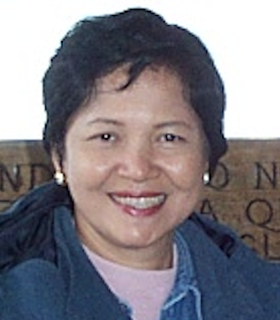
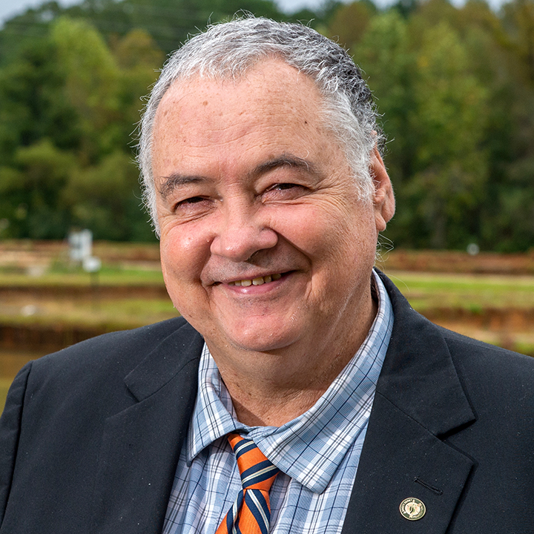
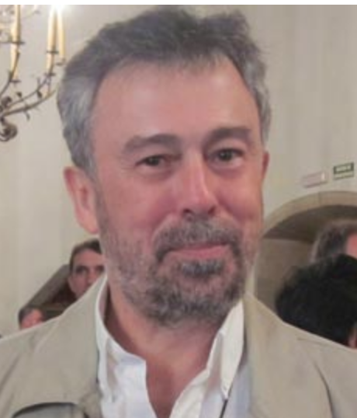
Symposium ISGA X (2009) Bangkok, Thailand
Uthairat Na-Nakorn
Symposium ISGA XI (2012) Auburn, USA
Rex Dunham
Symposium ISGA XII (2015) Stgo. de Compostela, Spain
Paulino Martínez

Slide 35
PUBLISHED PAPERS IN SPECIAL ISSUES OF AQUACULTURE ON EACH SESSION
SESSIONS | Galway 1882 | Davis 1885 | Oslo 1988 |  | Wuhan 1991 | Halifax 1994 | Stirling 1997 |  | Townsvi 2000 | P Varas 2003 | Montpel 2006 |  | Bangkok 2009 | Auburn 2012 | Stg Comp 2015 |  | Cairns 2018 | P Varas 2022
Population Genetics, genetic diversity, Electrophoretic Markers | 4 | 4 | 1 | 9 | 5 | 4 |  | 9 |  | 2 | 5 | 7 | 3 |  |  | 3
Quantitative Genetics, Breeding Plans, Selection Response, Environmental Effects | 12 | 8 | 9 | 29 | 8 | 8 | 9 | 25 | 12 | 6 | 8 | 26 | 5 | 7 | 7 | 19
Domestication and Response to Controlled Environments | 4 | 7 |  | 11 |  |  |  |  |  |  |  |  |  |  |  | 0
Inbreeding, Inbreeding Effects | 3 |  |  | 3 |  |  |  |  |  | 2 |  |  |  | 1 |  | 1
Hybrids and Hybridization | 4 |  |  | 4 |  | 3 |  | 3
Chromosomal Genetics and Ploidy Manipulations, | 4 | 7 | 2 | 13 | 7 | 4 | 4 | 15 | 5 | 5 | 2 | 12 | 2 | 1 |  | 3
Sex Reversal and Monosex, sex control, Sex determination | 3 | 2 |  | 5 |  | 1 | 5 | 6 |  |  | 1 | 1 |  | 1 |  | 1
Applications of Ploidy Manipulation. Polyploid performance |  | 2 |  | 2 |  | 2 | 1 | 3 |  |  |  |  |  | 1 |  | 1
Stock and strain Comparison, |  | 5 |  | 5
Immunology, Disease resistance & stress |  |  | 5 | 5 | 2 |  |  | 2 |  |  | 2 | 2
New fish species |  |  | 3 | 3
Transgenic fish, Molecular manipulation |  |  |  |  | 4 | 3 | 6 |  |  |  |  |  |  | 2 |  | 2
Conservation, Natural & cultivated Genetic resources |  |  |  |  |  | 5 | 7 | 12 | 2 | 7 |  | 9 |  | 1 |  | 2
Genetic markers (AFLP, QTL, RFLP, RAPD, MicroS) Genome Mapping, MAS |  |  |  |  |  | 2 | 8 | 10 | 4 | 4 | 5 | 13 | 7 | 4 | 2 | 13
Gene expression, functional genomics |  |  |  |  |  |  |  |  | 1 |  |  | 1 | 5 |  | 2 | 7
Genome selection, Genomic prediction |  |  |  |  |  |  |  |  |  |  |  |  |  | 2 | 2 | 4

Slide 36
Quantitative genetics and selective breeding
Applied genomics (Marker assisted selection and whole genome selection)
The number of papers dealing with marker technologies (QTL detection, genome mapping and marker assisted selection, genomic selection, etc.) during this last period have surpassed the number of papers dealing with quantitative genetics and selective breeding.
Conventional selective breeding with the assistance of quantitative genetics is still the major approach for genetic improvement of aquaculture species, and will remain with the new technologies, including MAS, GS integrated into selective breeding programs to accelerate genetic improvement
Notes:
º

Slide 37
Developing genomic resources and application of new technologies
Genetically improved ﬁsh, shellﬁsh and crustaceans developed through selection, intraspeciﬁc crossbreeding, interspeciﬁc hybridization, polyploidy, sex reversal (genetically monosex), and marker assisted selection are now being commercially applied for various species throughout the world.
Due to the rapid reduction in cost of genome sequencing and genotyping, MAS and GS are being applied to breeding programs in some species.

Slide 38
Genome editing (GE) is coming?
The GE technologies, especially GE with CRISPR/Cas9, are promising and have a great potential in accelerating aquaculture breeding.
Although the outcomes of GE are promising in aquaculture species, the integration of GE with conventional selective breeding is still in its infancy.
Notes:
º

Slide 39
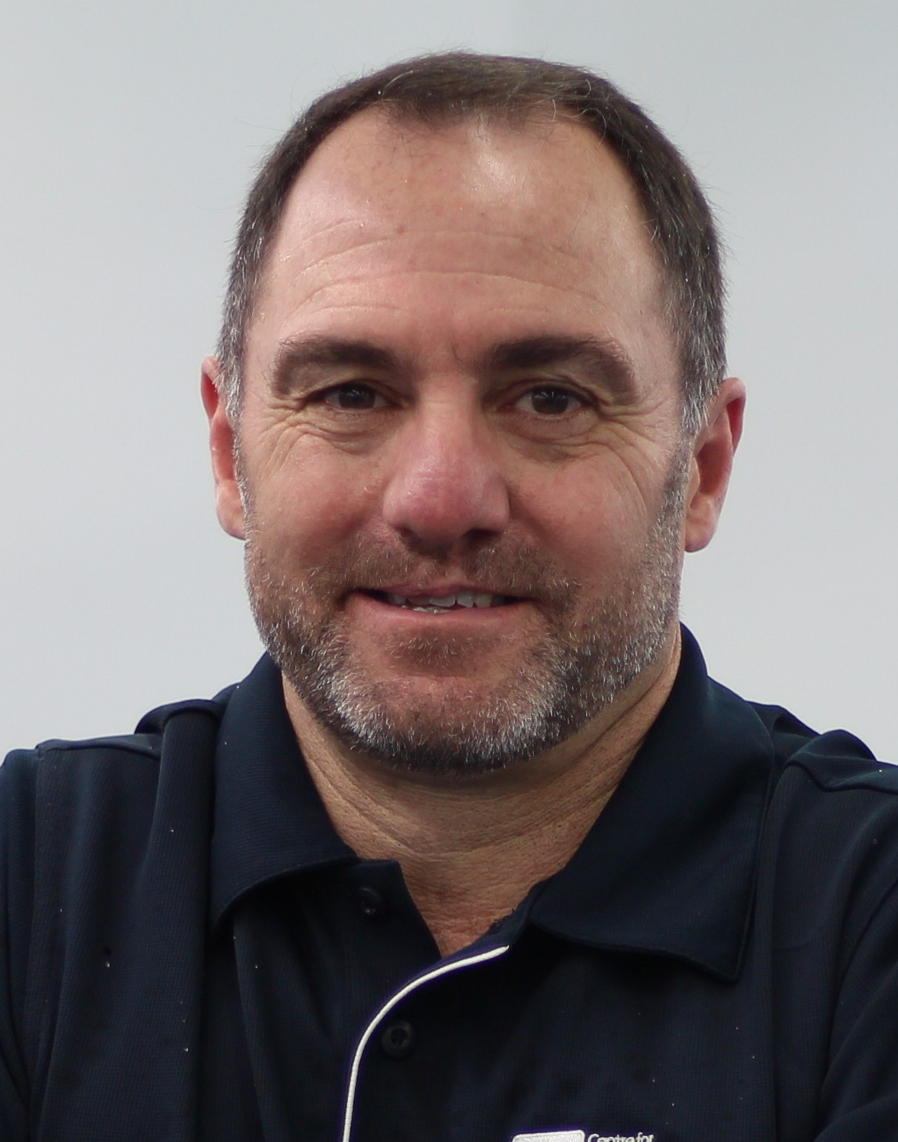
Sessions ISGA XIII (2018) Cairns, Australia
Biotechnology and functional genomics
Sex control
Genomic prediction
Selective breeding and quantitative genetics
Industry use of genetics
Genomic technology
Genetics of disease and stress
Genetics of nutrition
Epigenetics
Genomics and metabiomes
Population genetics
Ethics, food safety and environmental risk
Dean Jerry
Current status of research on aquaculture genetics and genomics-information from ISGA 2018. YubangShen & GenhuaYue
Aquaculture and Fisheries
Volume 4, Issue 2, March 2019, Pages 43-47

Slide 40
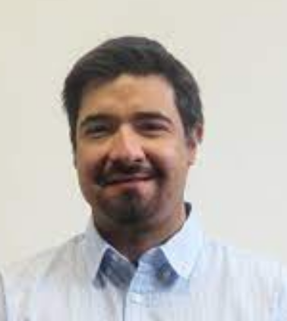
Sessions ISGA XIV (2022), Puerto Varas, Chile
Quantitative Genetics and Selective breeding
Genomic Prediction
Functional Genomics and Biotechnology
Sex Control
Population Genetic
Genetics and Genomics of Disease and Stress
Genetics and Genomics of Nutrition
Epigenetics
Genomes and Metabiomes
Industry genetics applications
Ethics, Food Safety and Environmental Risk
José Manuel Yáñez

Slide 41
Future trends of Aquaculture Genetics and Genomics
Breeding programs
Genome selection
Genome editing
Epigenetics, epigenomics
Genome Wide Association Studies (GWAS, ssGWAS)
Meta-Analysis of GWAS
Phenomic selection
Exome sequencing
Bio-economic tools in Breeding programs

Slide 42
Ways to estimate breeding values over time
Pedigree information
ANCESTRY
Production Information
PHENOTYPE
Molecular Information
QTL’s _ Genes SNP’s
Aditive Genetic Relationship Matrix (A⁻¹)
Genome Wide
Association Study
(GWAS)
Molecular Genetic Relationship Matrix (G⁻¹)
BLUP SELECTION :
(Best Linear Unbiased Predictor)
GENOMic SELECTION:
(BLUP with DNA information added)
Combined Relationship Matrix (H⁻¹)
MAS
Marker Assisted Selection
PEBV
Pedigree Breeding Values
GEBV
Genome Breeding Values
ssGBLUP
Single Step Genome Breeding Values
MAS EBV
MAS Breeding
Values

Slide 43


YEAR OF INITIATION OF BREEDING PROGRAMS (Incomplete)
Breeding Program defined as having an impact on production or in people
Chile was one of the pioneers in salmon genetic improvement
Milestones in fish breeding
Central Inst. of freshwater Aquaculture
AquaChile
Finland (MTT)
IFOP U.Chile
Akvaforsk
GIFT
Data from: Rye et al (2010) and Neira (2010)

Slide 44
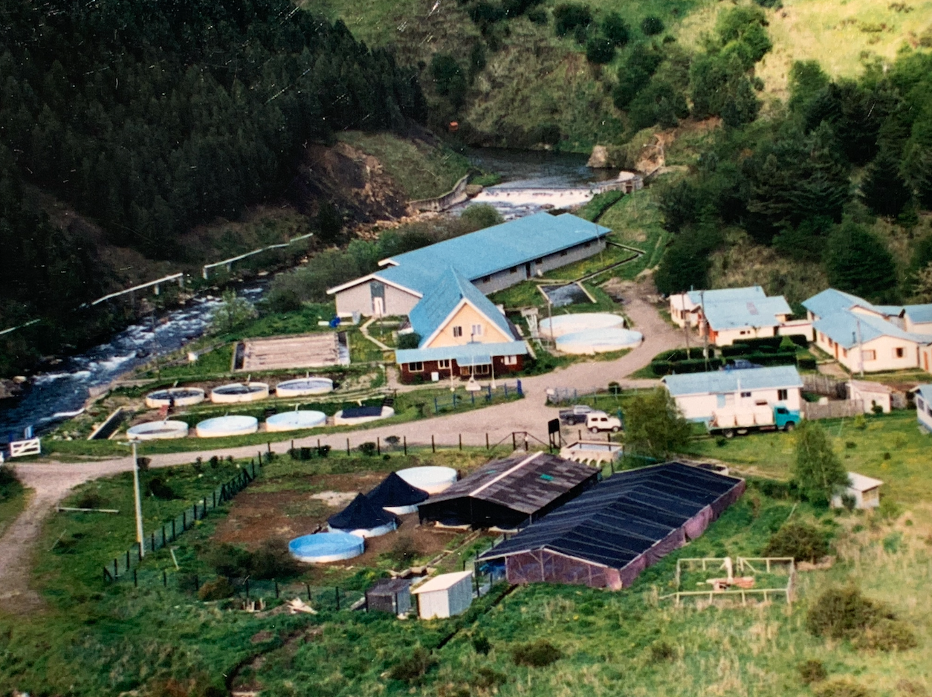
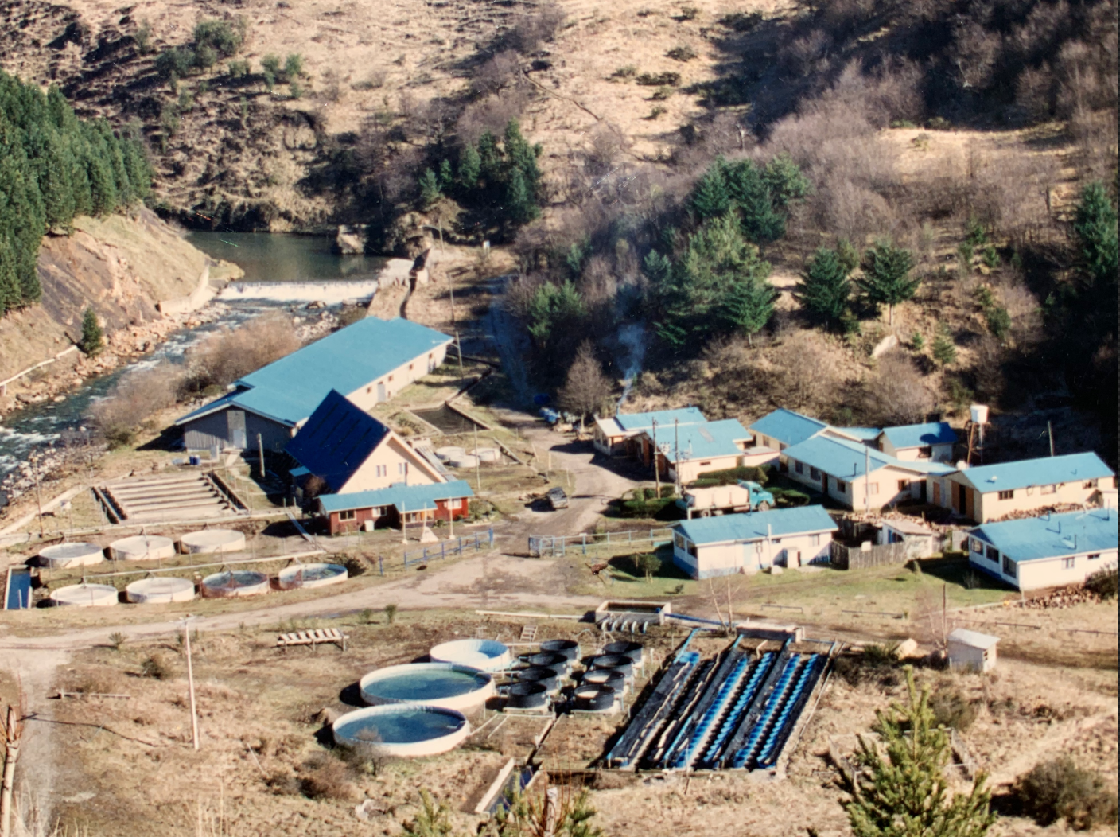
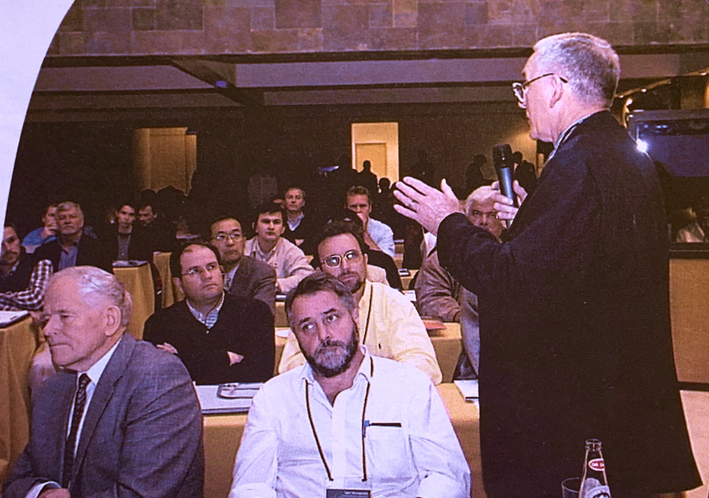
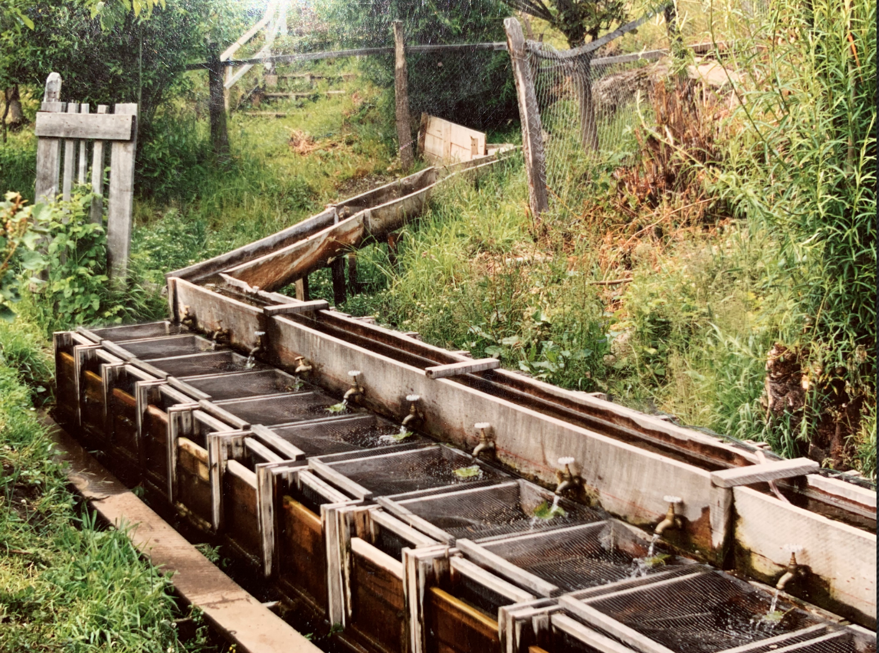
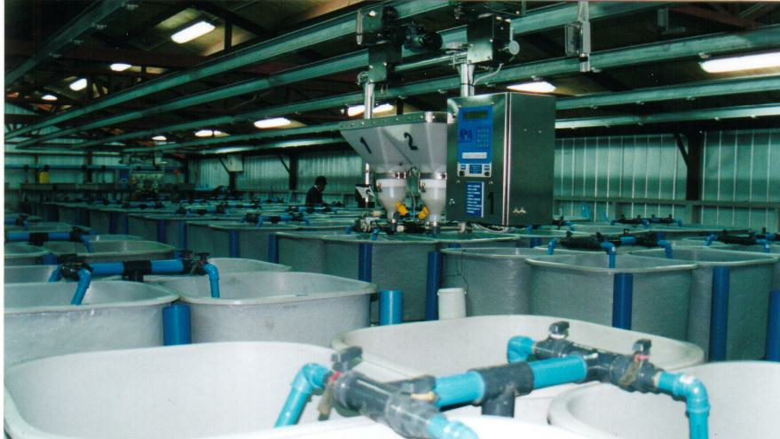
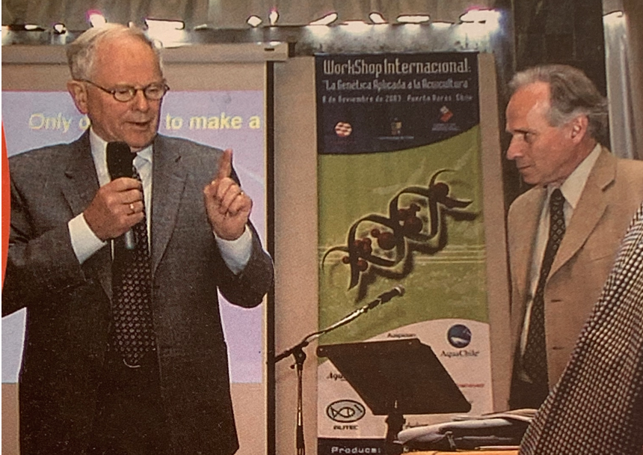
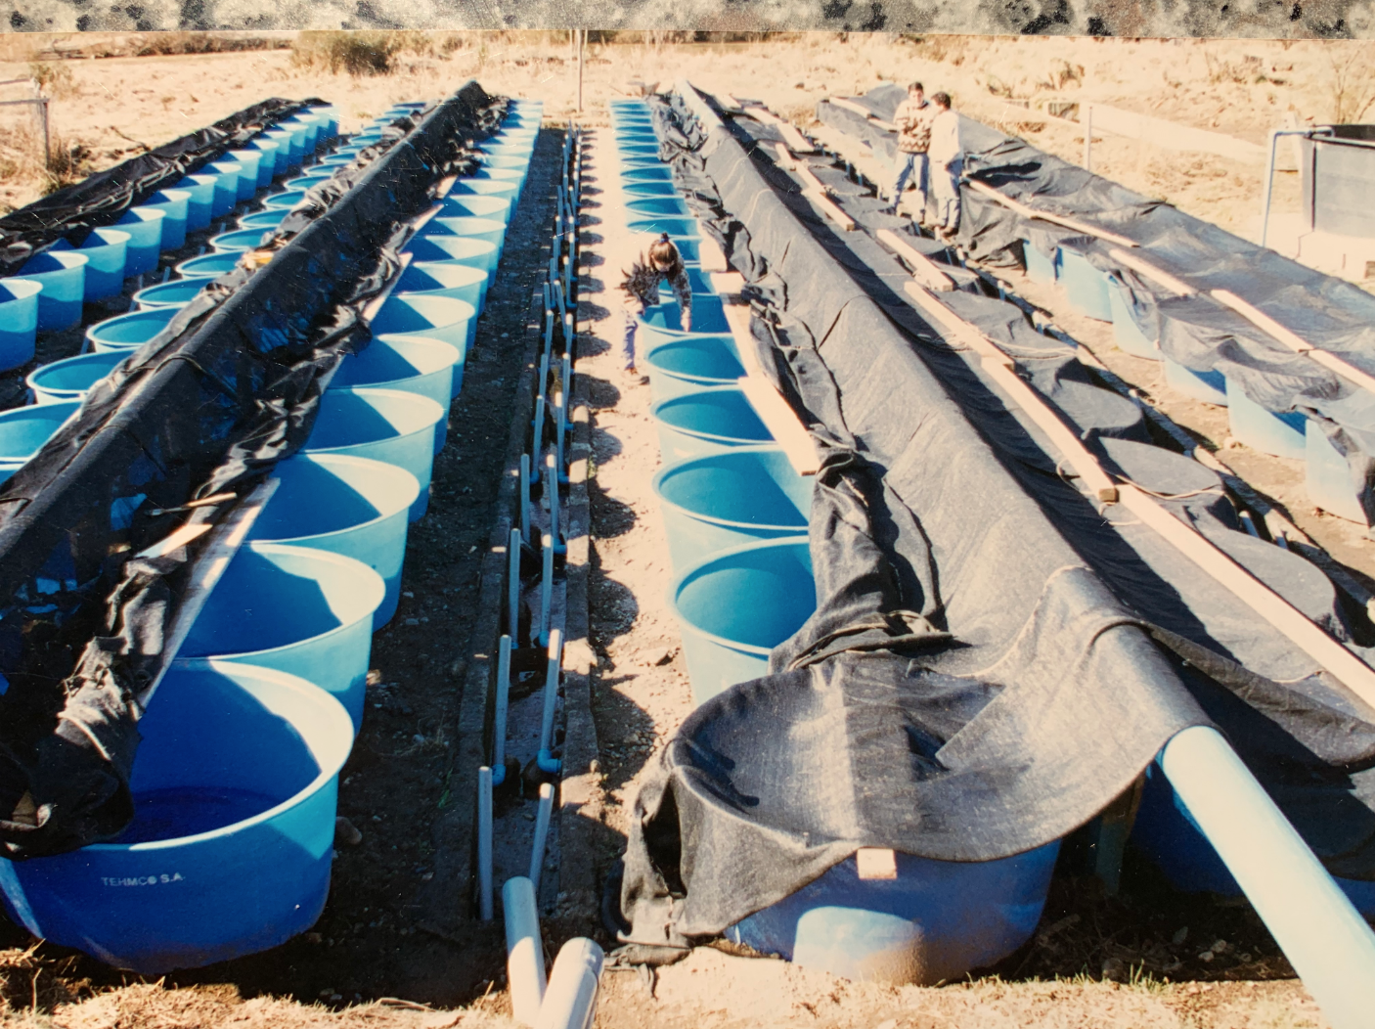
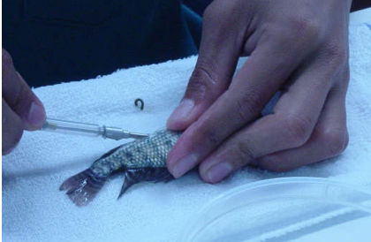
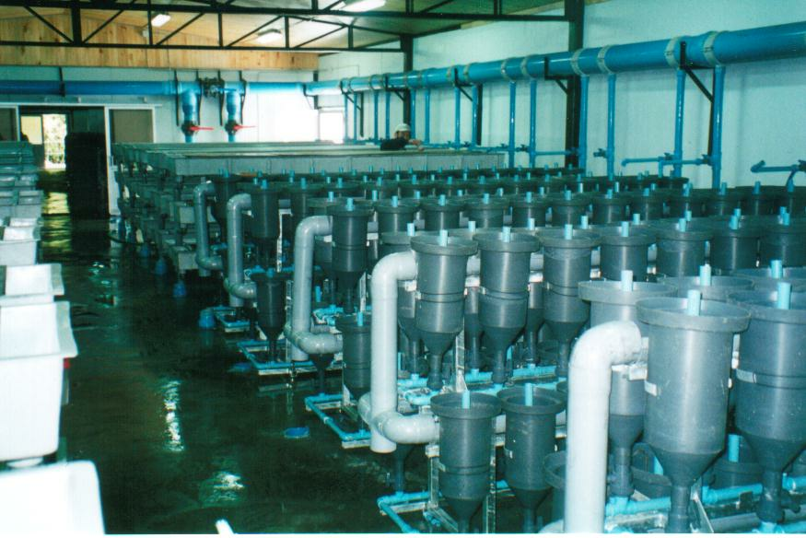
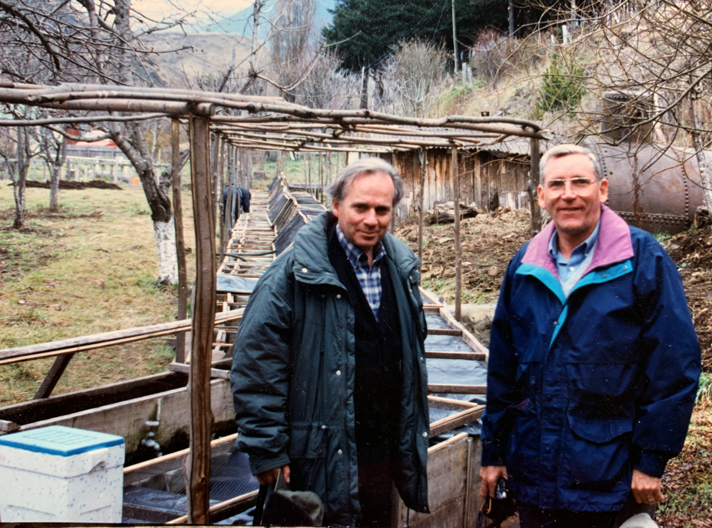
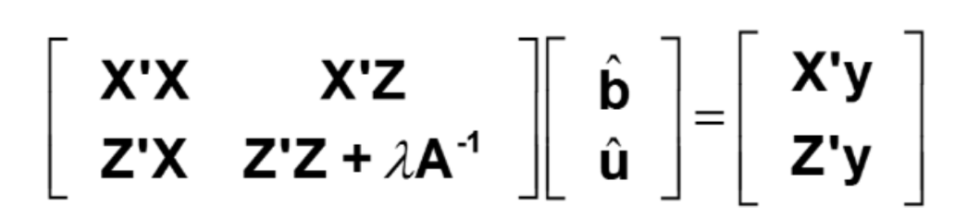
Chilean participation in aquacultural genetics and breeding
1986 Beginning of our research in fish breeding
1992 Coho Breeding Program (BP) in Cohyaique
      Use of Pit Tags and freeze branding at 5 grams
      Use of Animal models for estimating BVs
1997 Atlantic and coho salmon BPs in Aquachile
2000 Rainbow trout BP in Aquachile
2003 Genetics in Aquaculture VIII in Puerto Varas
“Genética Aplicada a la Acuicultura”
Notes:
º

Slide 45
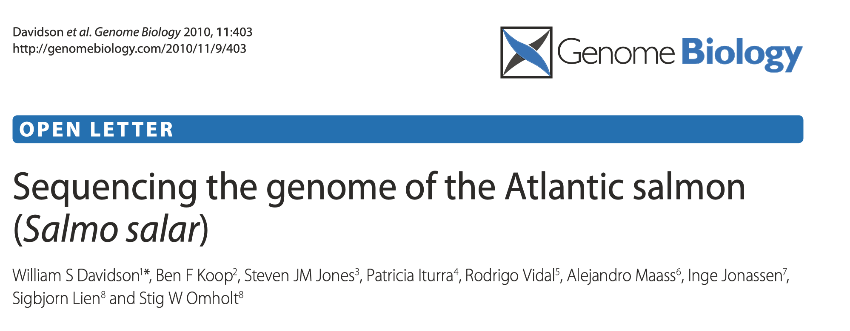
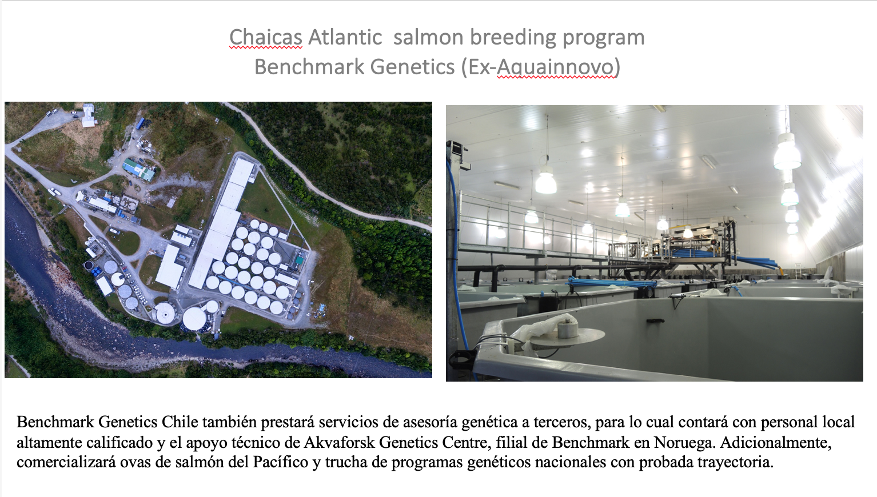
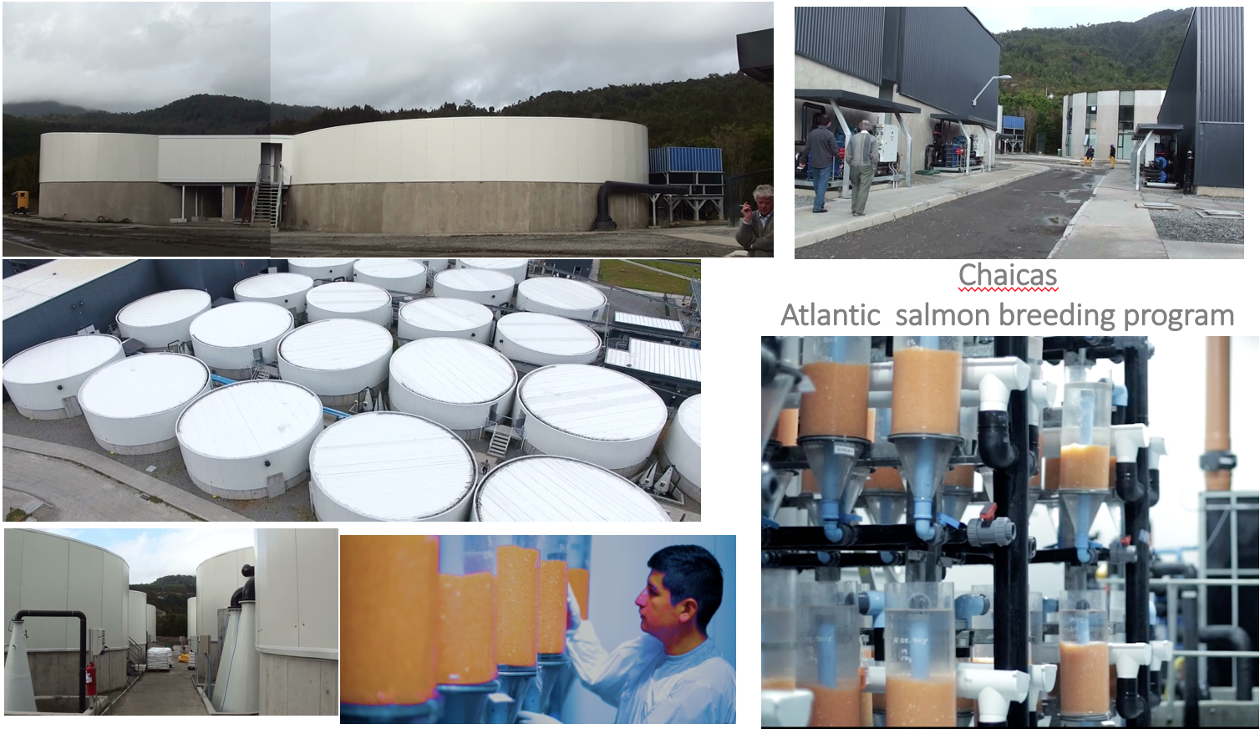
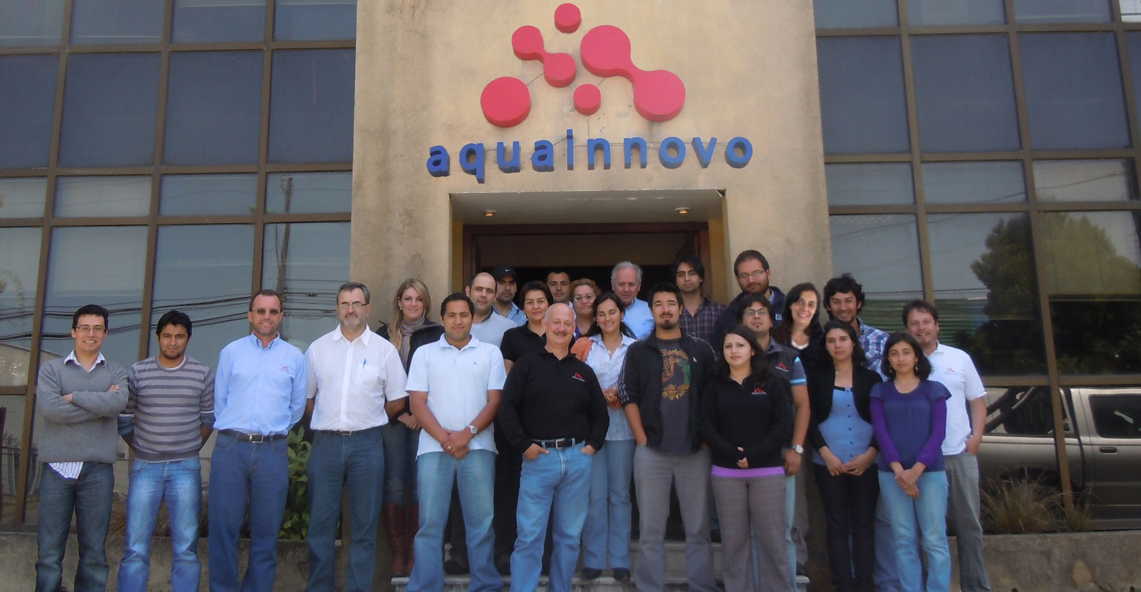
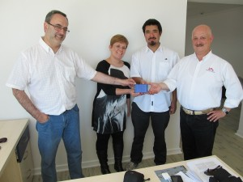
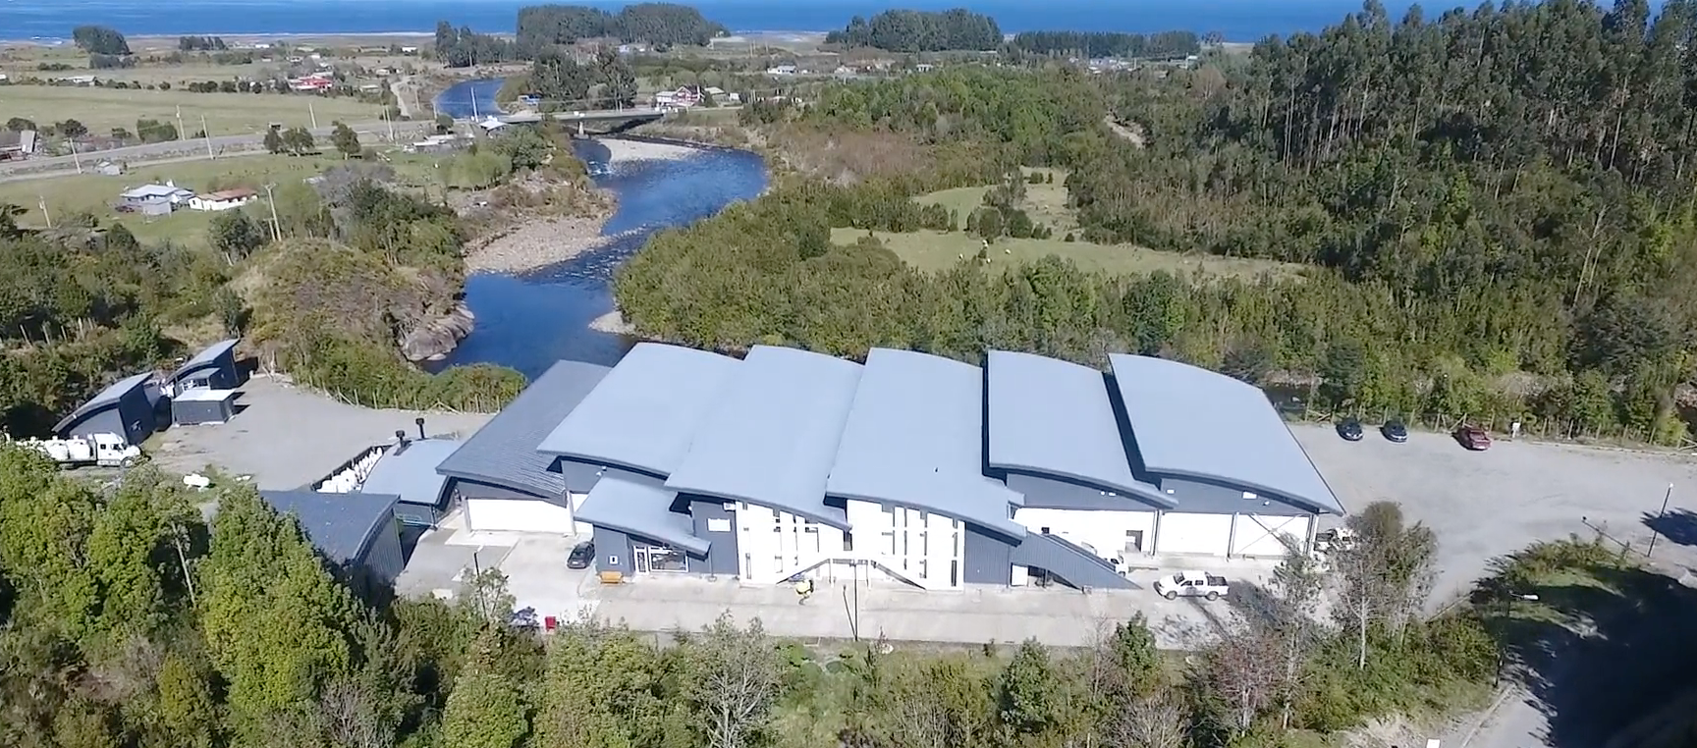
Chilean participation in aquacultural genetics and breeding
2007 U. of Chile was part of the Atlantic salmon
genome sequence project (cGRASP)
2007 – 2018 - Aquainnovo S.A.
Development of a 200K SNP Array for Atlantic Salmon: J.M. Yáñez, et.al. 2010

Slide 46
 | BREEDING PROGRAMS CURRENTLY OPERATING IN CHILE
COMPANY | AQUAGEN | BENCHMARK | AQUACHILE | HENDRIX | MOWI | CAMANCHACA | MULTIX | CALETA BAY | SALMONESANTARTICA | EFFIGEN | S.AYSEN
Presence | CE, Chile | CE, Chile | Chile | CE, Chile | CE, Chile | Chile | Chile | Chile | Chile | Chile | Chile
Type | Egg provider | Egg provider | Producer | Egg provider | Producer | Producer | Producer | Producer | Producer | Egg provider | Producer
Since | 1978 | 1996 | 1997 | 1998 | 2001 | 2007 | 2015 | 2015 | 2015 | 2001 | 2015-2018
Species | Salar, Trout, Coho | Salar | Salar, Coho | Salar, Trout | Salar | Salar | Salar | Trout | Trout | Trout | Coho
Salar Strain | AQ | SAGA | Landcatch | Landcatch | Mowi | Lochy, Fanad | Mix | Caleta Bay | S.Antartica | AqCh | NN
Genetic Competence | Aquagen | Benchmark | Hendrix, Benchmark | Hendrix | In house | PUCV | Xselect | UStgo | UChile | UChile | Hendrix
** |  | X | X | X | X | X | X |  | X | X
**/ Programs marked with an X are actually run by a graduate geneticist from our group

Slide 47
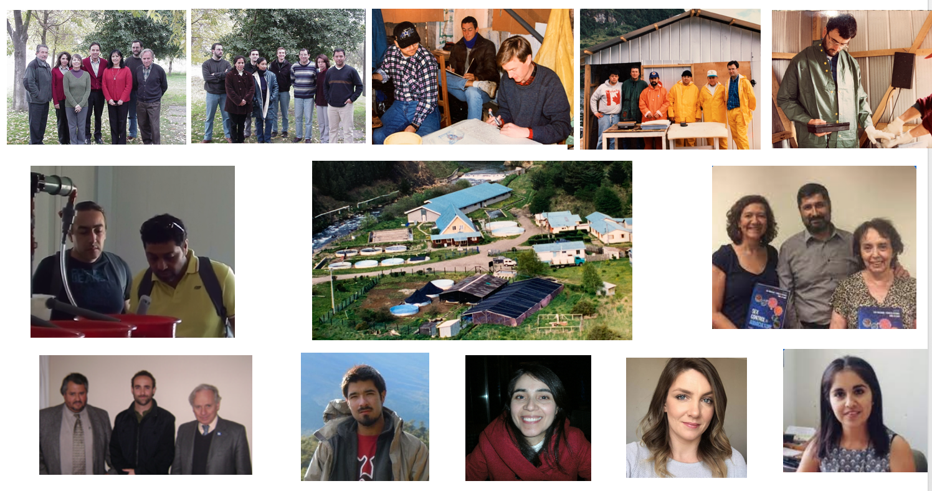
Our best contribution: Excellent geneticists and excellent persons

Slide 48
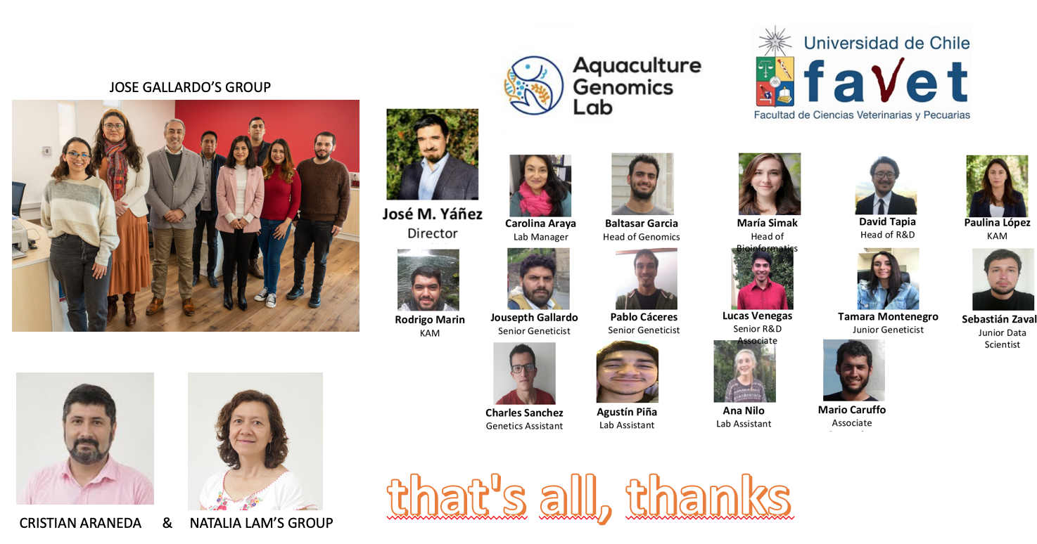
Our best contribution: Second generation of Chilean aquacultural geneticists

